Slide 1
Password Hashing
Cryptographic Hash Functions | Hashed Passwords and Password Cracking | bcryptjs | Using Database
Notes:
Welcome to our lecture on password hashing. In this lecture we will go through cryptographic hash functions, how to hash and crack passwords, bcrypt JS, how to store hashed passwords in database. Let’s start the video lecture.

Slide 2

Cryptographic Hash Functions
Store minimal sensitive data to protect users.
Never store passwords as plain text in a database.
Use cryptographic hash functions to hash passwords.
Common hashing methods: MD5, SHA-1, bcrypt, PBKDF2.
Notes:
When handling sensitive information, security is a top priority. Storing only necessary data helps protect users from potential risks. Passwords should never be stored in a readable format. Instead, they should be converted into a secure representation using specialized methods. These techniques make it much harder for unauthorized access to compromise stored credentials.

Slide 3
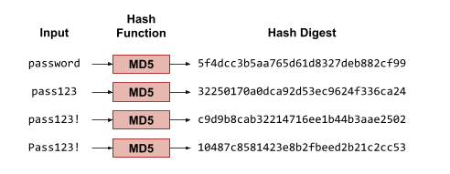
Example
Notes:
Now that we understand the importance of securing passwords, let’s examine how they are transformed using encryption techniques. A password is processed through a specialized function, producing a unique output that represents the original input. Even small variations in the original input create completely different results, making it difficult to reverse-engineer the data.

Slide 4
Hashed Passwords
Store only password hashes, not plain text passwords.
Authenticate users by hashing their input and comparing it to the stored hash.
Matching hashes confirm the correct password was provided.
Notes:
Now that we have seen how passwords are transformed, let’s discuss how they should be stored securely. Instead of keeping the original input, only the encrypted version is saved. When a user logs in, their input is processed the same way, and the result is compared to the stored version. If both match, access is granted, ensuring security without exposing sensitive data.

Slide 5
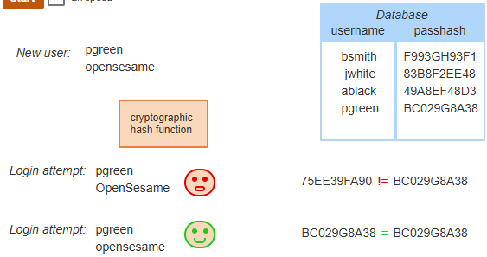
Example
Notes:
Now that we understand how password security works, let’s see how authentication is verified. When a user creates an account, their input is converted into a secure format and stored. During login, the system processes the input the same way and checks for a match. If the results align, access is granted. If they do not, the login is denied, preventing unauthorized access.

Slide 6
Password Cracking
Password cracking tries to recover passwords from stolen hashes.
Dictionary attacks compare hashed words to stolen hashes.
Precomputed tables speed up dictionary attacks.
Salting passwords makes cracking much harder by adding randomness.
Notes:
Now that we have seen how passwords are secured, let’s discuss how attackers try to break them. Various techniques are used to uncover stored credentials by comparing known patterns or using precomputed data. To counter these threats, additional security measures are implemented to make guessing much more difficult, adding extra layers of protection.

Slide 7
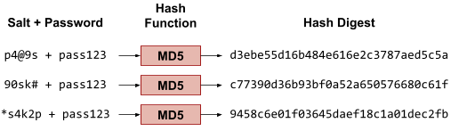
Example
Notes:
Now that we understand common password-cracking methods, let’s explore how adding randomness strengthens security. By combining an extra unique value with the original input, the system ensures that even identical inputs produce different results. This approach significantly increases protection, making it much harder for attackers to predict or match stored credentials.

Slide 8
Strong Password
A strong password is a password that is difficult to guess. A strong password has the following characteristics:
Does not contain words found in a dictionary or on the web
Composed of uppercase and lowercase letters, digits, and perhaps punctuation
At least 10 characters in length
Has not been used as a password before on the same website or on any other website
Does not conform to popular password patterns like an initial capital letter, 2-4 digits at the end, or adding ! at the end
Notes:
Now that we have seen how passwords are secured, let’s discuss how to create a strong one. A secure password should be unpredictable and difficult to guess. It should be long enough, include a mix of different characters, and avoid common patterns. Reusing the same password across multiple sites increases risk, so unique credentials should always be used for better security.

Slide 9
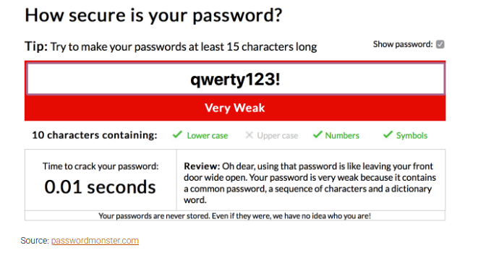
Example
Notes:
Now that we have discussed what makes a strong password, let’s look at an example of why it matters. Weak credentials can be easily guessed, making them vulnerable to attacks. Short, predictable combinations are cracked in seconds. By using longer, more complex credentials with a mix of characters, security is significantly improved, reducing the risk of unauthorized access.

Slide 10
bcryptjs
MD5 & SHA-1 are weak; use bcrypt, scrypt, or PBKDF2 instead.
bcryptjs is a popular Node.js module for password hashing.
Install with npm install bcryptjs.
hashSync() creates a 60-character hash with a random salt.
compareSync() checks if a password matches a bcrypt hash.
Bcrypt hash structure: Algorithm, cost factor, salt, and hash digest.
Notes:
Now that we have seen the weaknesses of outdated security methods, let’s explore a more secure approach. Advanced encryption techniques provide stronger protection by incorporating randomness and complexity. This method ensures that credentials remain secure, even if an attacker gains access to stored data. Using modern techniques significantly improves password security.

Slide 11
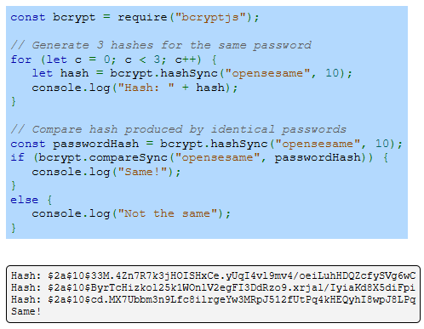
Example
Notes:
Now that we have introduced advanced encryption techniques, let’s see them in action. Each time a value is processed, it produces a unique result, even if the original input is the same. This added randomness strengthens security by preventing attackers from matching stored credentials. Comparing values ensures accuracy while maintaining strong protection against breaches.

Slide 12
Using Database
/api/user (POST) hashes passwords with bcrypt.hashSync() and stores user data.
/api/auth (POST) verifies passwords with bcrypt.compareSync() and returns a JWT.
/api/status (GET) validates JWT and returns all usernames and statuses.
Notes:
Now that we have covered secure password handling, let’s see how this integrates with data storage. When a user registers, their credentials are processed and saved securely. During login, the stored information is verified to ensure authenticity. The system also manages user access, validating credentials and retrieving necessary details while maintaining security and efficiency.

Slide 13
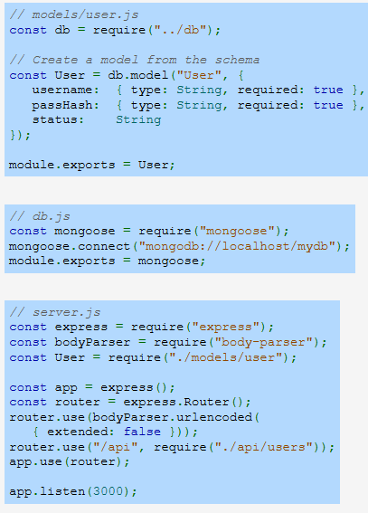
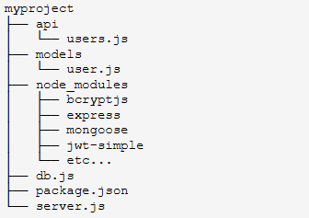
Example
Notes:
Now that we have covered how data is managed, let’s look at the system’s structure. The project is organized into different sections, each handling a specific function. The database stores user records, the system processes data, and secure encryption ensures protection. This structured approach allows for efficient handling of user interactions while maintaining security.

Slide 14
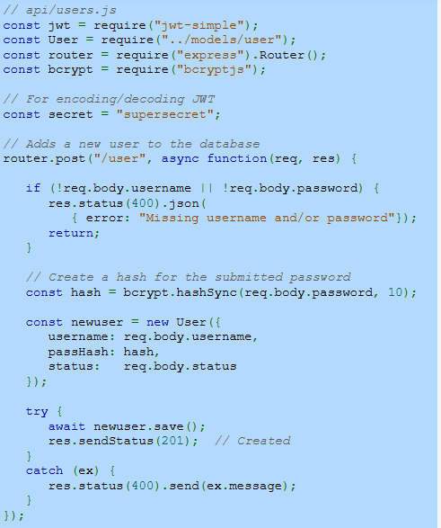
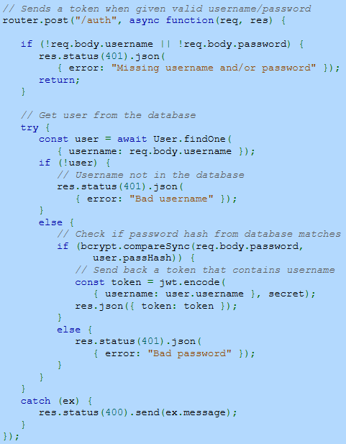
Example (Continue)
Notes:
Now that we understand how data is stored and verified, let’s look at how the system processes user registration and authentication. When a new account is created, the system secures the credentials before saving them. During login, the stored data is retrieved and compared to ensure accuracy. This approach helps maintain security while allowing users to access their accounts seamlessly.

Slide 15
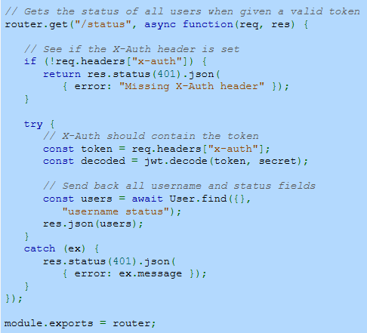
Example (Continue)
Notes:
Building on the previous process, the system also manages user access by verifying identity through secure tokens. Once a user is authenticated, their details can be retrieved securely. The system checks for proper authorization before providing information, ensuring that only verified users can access certain data. This structured approach enhances security while maintaining efficiency.

